Slide 1
VOICE RECORDER & SPEECH PROCESSING IN MATLAB
​
PRESENTED BY
SHREYA V
21ECR191

Slide 2


Agenda
A
Introduction
Procedure
Program
Outputs
Conclusion

Slide 3
Introduction
Speech is a form of communication in everyday life.
Applied to high technological telecommunication systems.
Speech signal processing: signal Analysis in terms of sinusoidal components of various frequencies (the Fourier domain).
MATLAB : Tool used to record audio signal and analyse it’s frequency components.

Slide 4
Procedure
Create an audio recorder object.
Call the record or record blocking method.
Create a numeric array corresponding to the signal data using the get audio data method.
FFT of the recorded audio signal is plotted using ‘fft’ function.
Convolution of the recorded audio signal is plotted using ‘conv’ function.
FIR and IIR filters of the recorded audio signal is plotted by taking in the cut off frequency as the input.

Slide 5
Program
TO RECORD AN AUDIO:
Fs=8000; Sampling frequency in hertz.
Nseconds=input("Enter the duration to record "); Time period to record an audio is taken as input.
recorder=audiorecorder(Fs,nbits,ch); To start recording the audio.
recordblocking(recorder,Nseconds); To stop recording in the defined time.
x=getaudiodata(recorder,datatype); Conversion of recorded audio to numeric array
audiowrite('test.wav',x,Fs); The recorded audio is written in a file “test”.
[x,Fs] = audioread('test.wav’); The recorded audio is given as the parameters of the plot.

Slide 6
Program
TO PLOT IT’S FFT & CONVOLUTION:
[data, fs] = audioread('test.wav’); The numeric array of audio is fed into ‘data’.
data_fft = fft(data); FFT of ‘data’ is obtained using the function ‘fft’.
plot(abs(data_fft(:,1))) ‘Magnitude’ of the fft of data is plotted.
out=conv(selected_t,selected_x); ‘Convolution is performed using ‘conv’ function.

Slide 7
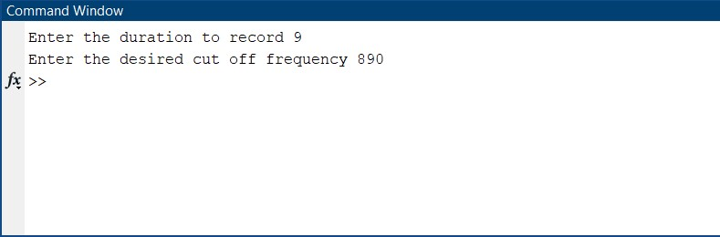
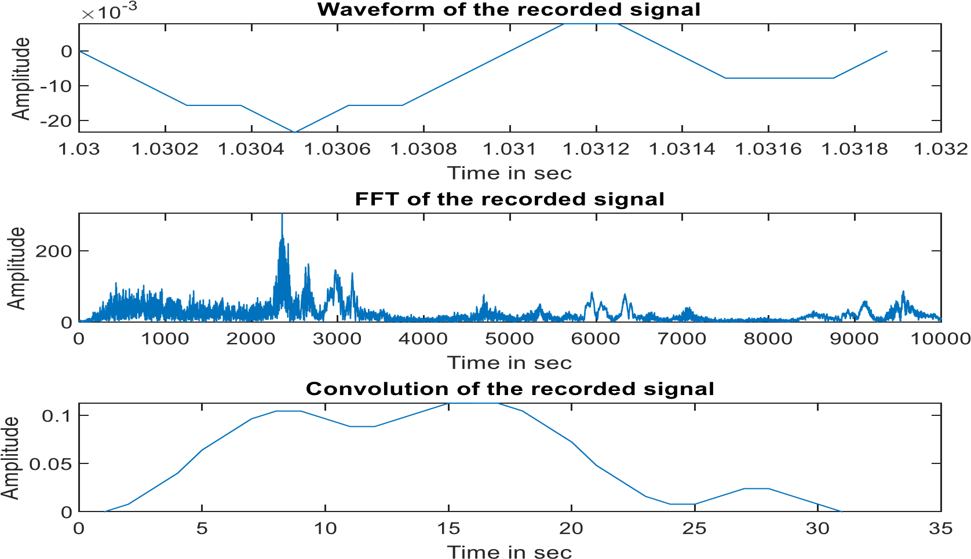
OUTPUT

Slide 8
Program
TO PLOT THE DESIGNED FIR BAND PASS & IIR FILTERS:
[y,Fs] = audioread('test.wav’); The recorded audio is read.
Fl = 300; Fh = 3400; Lower cut off frequency and higher cut off frequency is set.
Wc = [Fl Fh].Fs; Wc is determined here.
bbp = fir1(256, Wc, 'band’); Band pass filter is designed.
plot (1:length(bbp), bbp)
freqz(bbp,1) outbp = filter(bbp,1,y); To convert the components from laplace domain to Z – domain.
audiowrite('filtered_audio.wav',outbp,Fs); The desired audio signal in the given range of frequency is written in the same file.

Slide 9
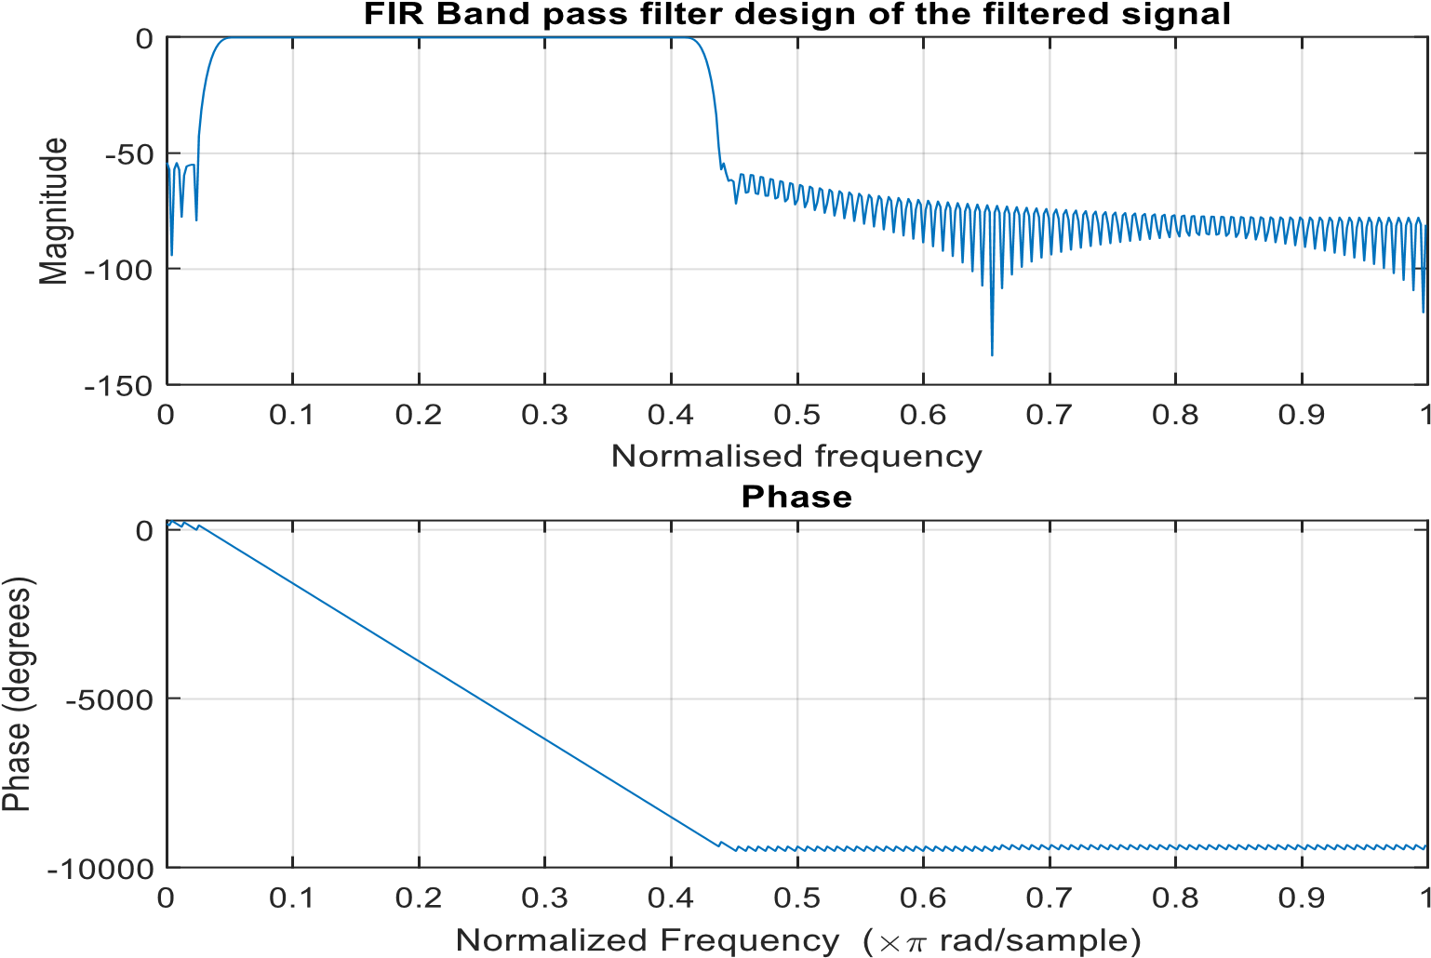
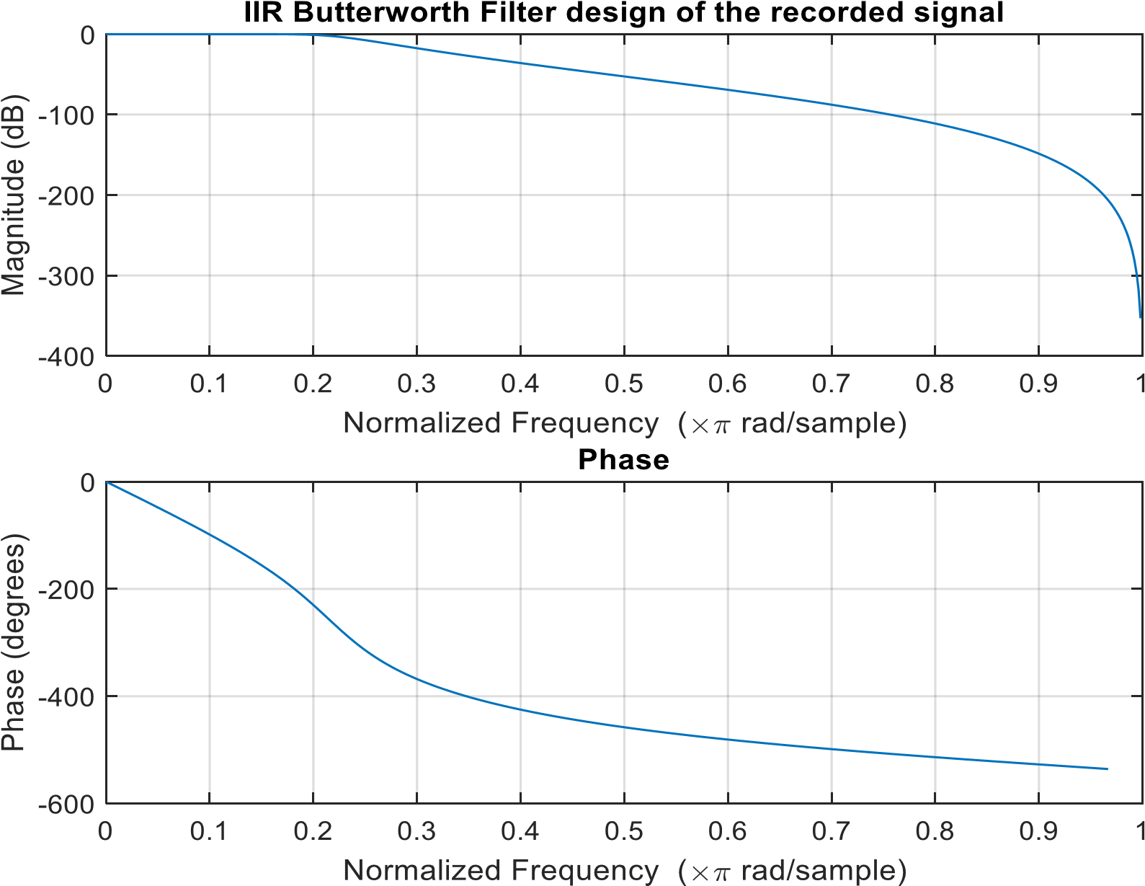
OUTPUT

Slide 10
CONCLUSION
“
Voice processing is a very deep subject.
It is rooted deeply in advanced mathematics and signal processing techniques.
This Mini project can be seen as a gateway or entry level for speech processing applications.
”

Slide 11
Thank you
REFERENCE LINKS :
https://in.mathworks.com/matlabcentral/answers/825-speech-recognition-coding
https://ieeexplore.ieee.org/document/6057603
https://ieeexplore.ieee.org/document/925457

